Slide 1
Stock Price Detection Using LSTM
Name: Abue Ammar ID:011162134
Name: Md. Shihab Hossain ID:011173066
Name: Md. Imtiaz Hossain Shovon ID:011143129
Name: Alif Nomani Rahman ID: 11142107

Slide 2
Problem Definition
Stock price prediction and stock price movement patterns have long been a hot topic in academia.
While the well-known efficient market hypothesis rules out any prospect of reliable stock price prediction, formal assertions in the literature show that accurate modeling of predictive systems can allow us to anticipate stock prices with a high level of accuracy.
In this research, we offer a set of deep learning-based regression models that forecast stock prices with a high level of accuracy.

Slide 3
Dataset Description
Dataset name: NSE-TATA
● No of instances=1236
● No of attributes=8 (Date, Open, High, Low, Last, Close, Total trade, Turnover)

Slide 4
LSTM MODEL
lstm_model=Sequential()
lstm_model.add(LSTM(units=50,return_sequences=True,input_shape=(x_train_data.shape[1],1)))
lstm_model.add(Dropout(0.2))
lstm_model.add(LSTM(units=50))
lstm_model.add(Dropout(0.2))
lstm_model.add(Dense(1))

Slide 5
Our Approach
1. Read the dataset.
2. Analyze the closing prices from dataframe.
3. Sort the dataset on date time and filter “Date” and “Close” columns.
4. Normalize the new filtered dataset.
5. Build and train the LSTM model.
6. Take a sample of a dataset to make stock price predictions using the LSTM model.
7. Visualize the predicted stock costs with actual stock costs.

Slide 6
Result
Date Close Predictions
2017-10-09 208.3 214.755386
2017-10-10 208.45 215.655914
2017-10-11 209.4 216.462387
2018-10-04 218.2 246.839752
2018-10-05 209.2 244.557617
2018-10-08 215.15 240.682114

Slide 7
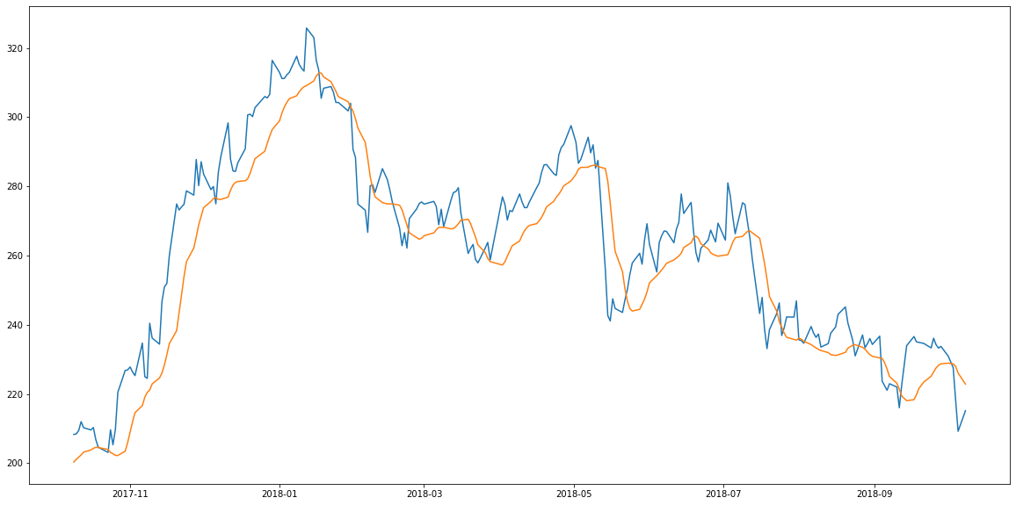
Result

Slide 8
Thank You
Notes:
Code:
https://colab.research.google.com/drive/1pMLdRbB-LZFVTLl4_A0EYiOmYl_AeGc9?authuser=1#scrollTo=1A4qAbSe6UIx

